Slide 1
Food Analysis
Everything you need to know about food nutrients
Ana Cristina Carmona
Margarita Garza de León
Claudia Encinas

Slide 2

Overview
The vast world of food choices we have within our reach can leave us overwhelmed on our food choices and how they contribute to our overall nutrition. Fortunately, Food is very DATA oriented!
Notes:
theme

Slide 3
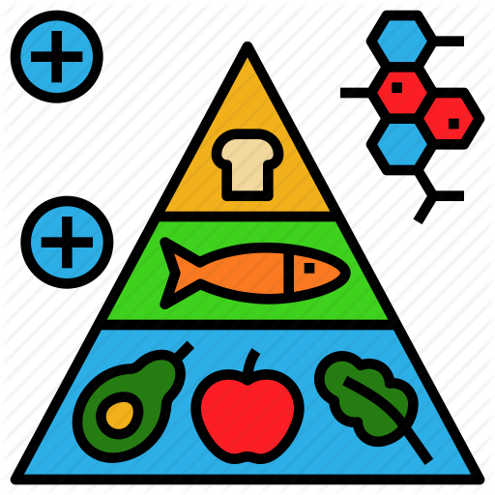
Project objective:
explore data for the user to understand nutritional content and values.

Slide 4

Our database
https://corgis-edu.github.io/corgis/csv/food/

Slide 5
What can we visualize? - food category and nutrient
Nutrient description
Food with < 100 cal.
Category’s calories
Provide the description of the essential nutrient of the user’s choice.
Provide a bar chart of all the food within the food category that contains less than 100 calories.
Provide a histogram to visualize the spread of caloric values of the different foods within the food category.

Slide 6
What can we visualize? - food description
Fat composition, Minerals and vitamins
Nutrition facts
One radar chart for each nutrient (fat, minerals and vitamins) from the food description the user selected.
Nutrition of facts table providing 7 nutrients from the food description the user selected.

Slide 7
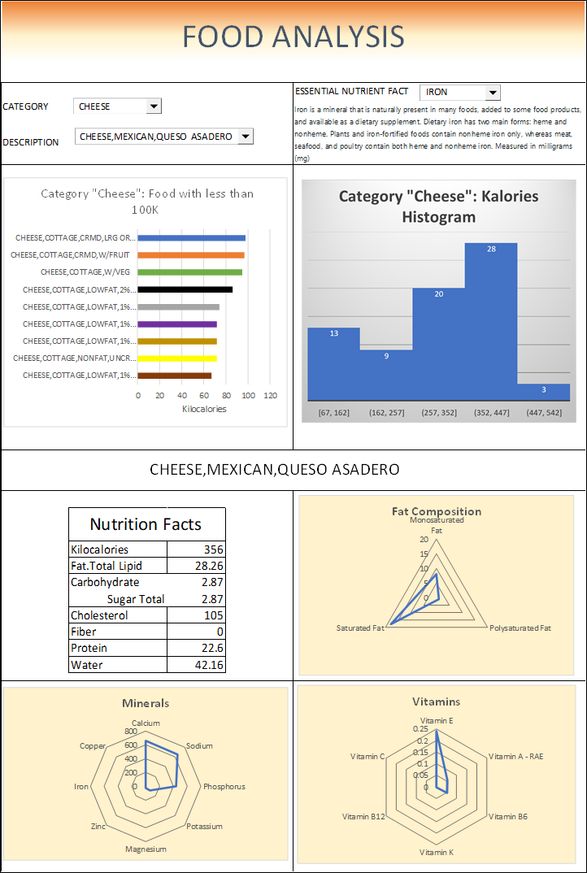
Our sketch -
We imagined our site displaying the information in the following manner

Slide 8
Data munging techniques
Upload of USDA csv
Web scrapping https://corgis-edu.github.io/corgis/csv/food/
Removal of unnecessary columns
Create a list of the column titles and split results
Create table:
essential group nutrient
Essential nutrients
Food category
Food catalog
Food tbl
Interesting facts
SQL connection and Database Upload

Slide 9
Website visualization

Slide 10





Our Coding Approach
CSV Upload
Web scrapping
https://corgis-edu.github.io/corgis/csv/food/
Python Flask API
Available Routes:
/api/v1.0/category
/api/v1.0/nutrients
/api/v1.0/onChangeCategory/idCategory
/api/v1.0/onChangeFood/idCategory
/api/v1.0/onChangeNutrient/idNutrient
PLotly
D3.js
Bootstrap
AOS.js
Relational Database
PostGreSQL

Slide 11
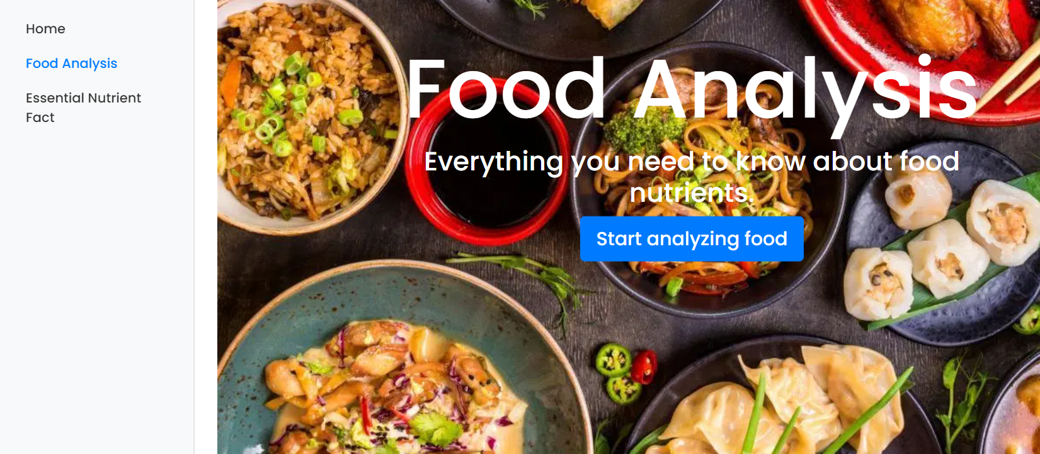
Home page
Used API Routes on the upload of the Home page :
/api/v1.0/category
/api/v1.0/nutrients

Slide 12
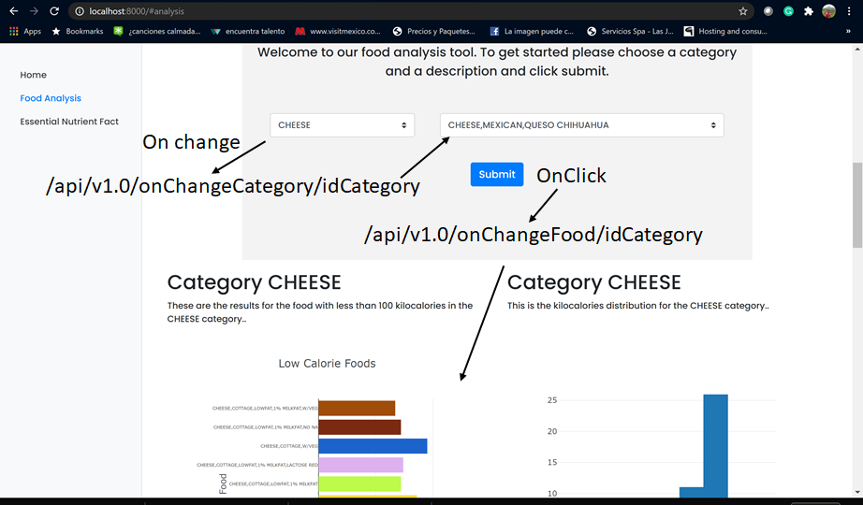
Food Analysis page

Slide 13
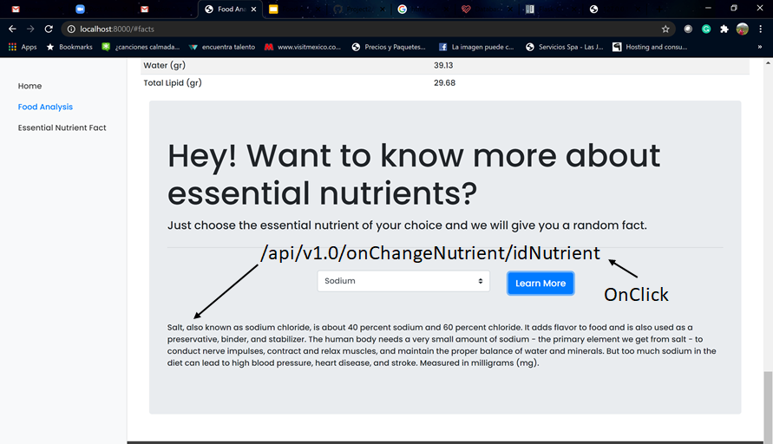
Essential Nutrient Fact page

